Slide 1
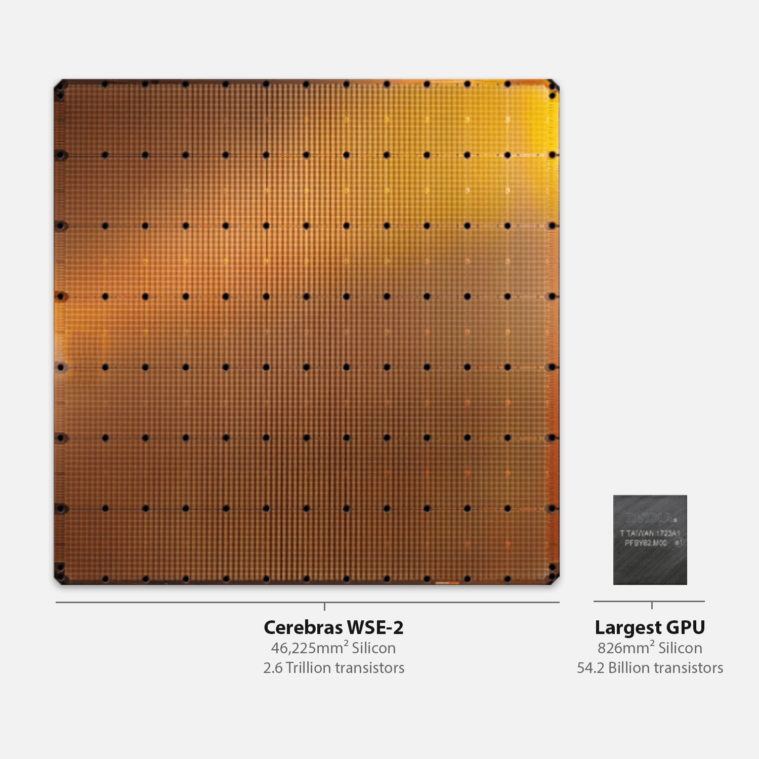
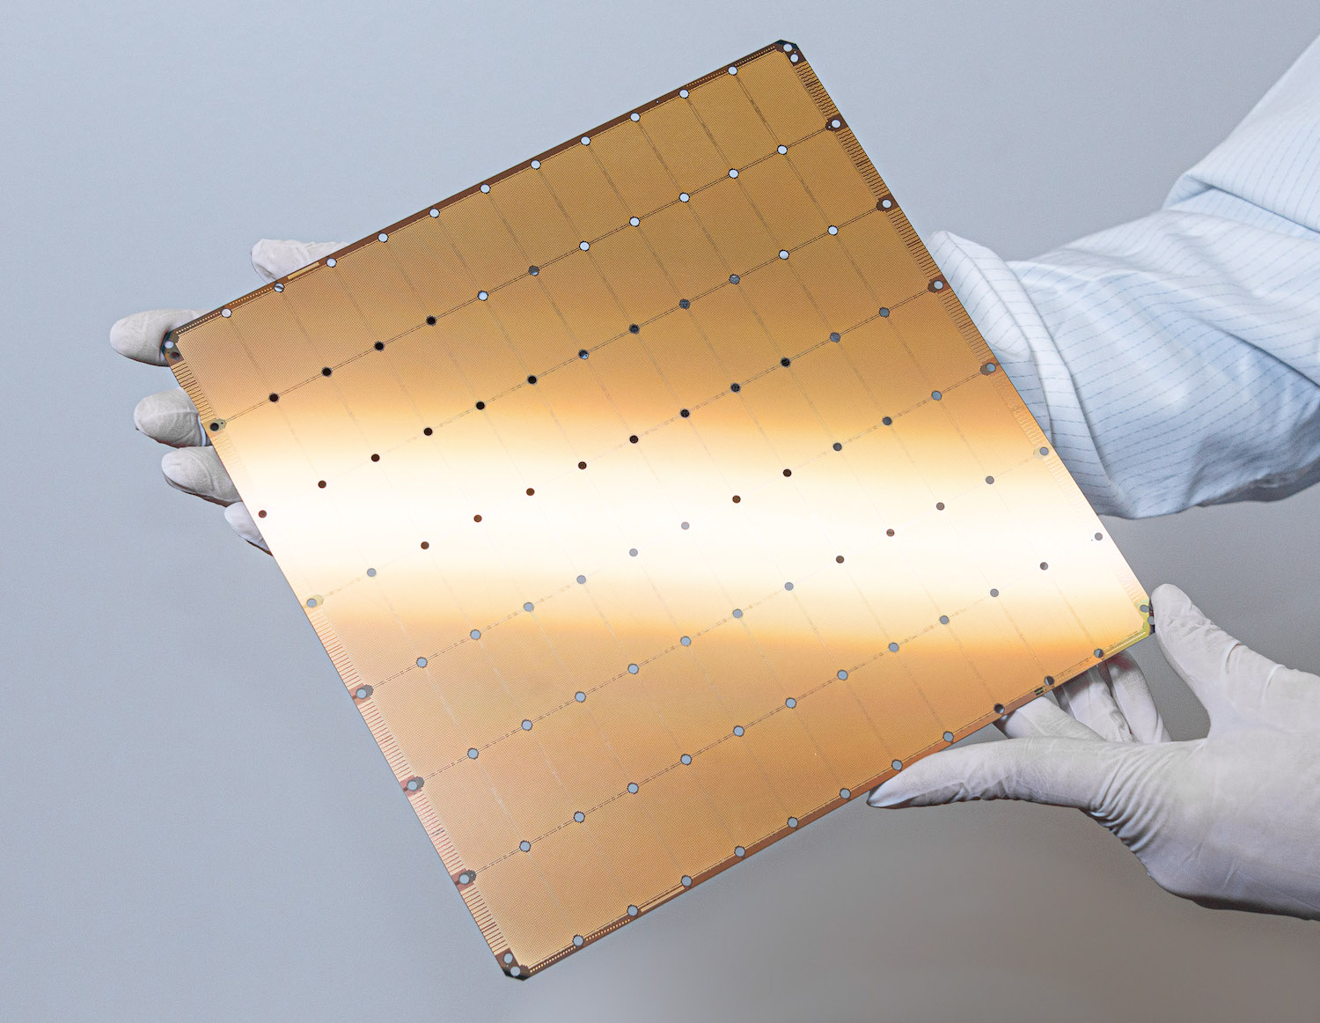



An overview of the CS-2 architecture

Slide 2

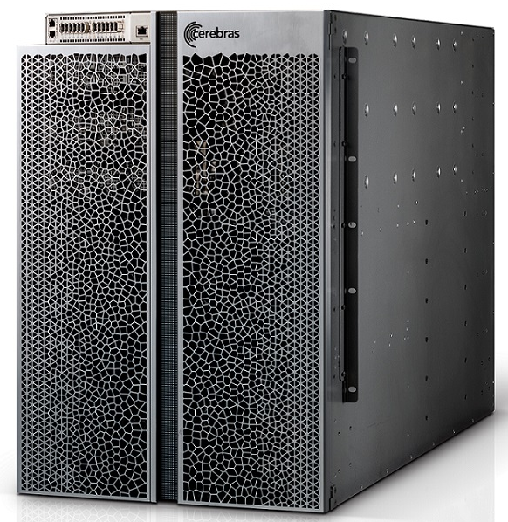
We have a (fairly big) box
This contains all the cooling and infrastructure support
15RU and draws around 23kW of power
Uses standards-based power and network connections
12x standard 100 Gigabit Ethernet links and converts standard TCP-IP traffic into Cerebras protocol at full line rate
This all serves the Cerebras Wafer Scale Engine (WSE)
A wafer-parallel compute accelerator, containing hundreds of thousands of independent processing elements (PEs)
The WSE is the reason for the tutorial!

Slide 3
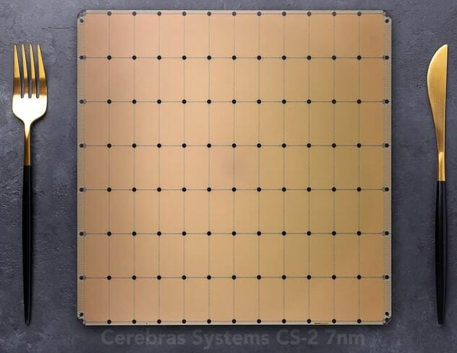
Cerebras Wafer Scale Engine (WSE)
Physically it is about as big as a dinner plate and built upon a 7nm process technology
The current generation CS-2 that we will use today contains:
Approximately 850,000 cores
Each core is individually programmable
40GB on-chip SRAM memory
A total of 20PB/s aggregate memory bandwidth
The flexibility of the individual, independent cores and the large amount of memory means that, depending on the workload, the CS-2 is capable of delivering the performance of many GPUs
Although of course this depends heavily on you programming it effectively, which is the topic of the tutorial today!

Slide 4
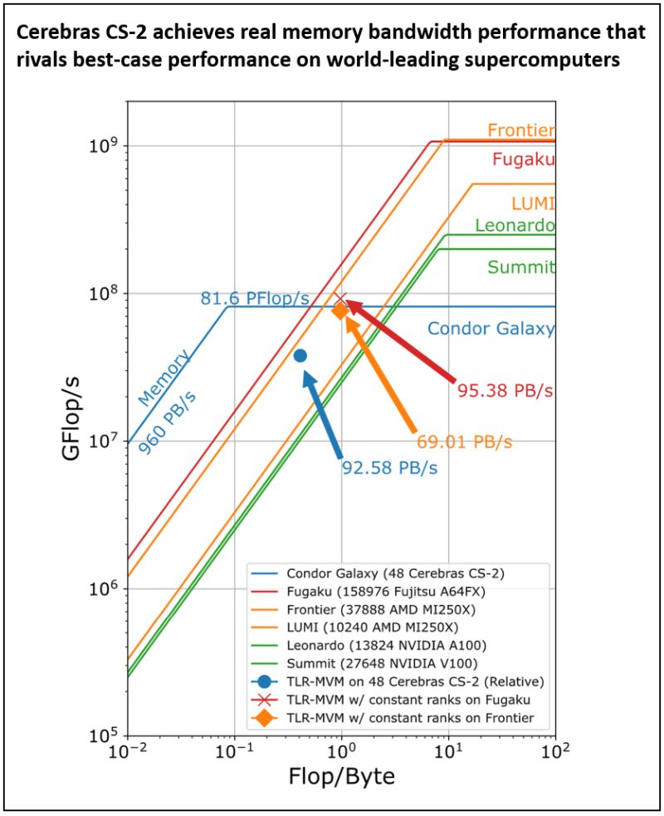
What types of application suit the WSE?
Scaling poorly across multiple nodes (e.g. FFTs, particle simulation)
The WSE has a fabric that is high bandwidth and low-latency, allowing for excellent parallel efficiency for non-linear and highly communicative codes
The CS-2 system has 850k cores and can fit problems on an individual chip that take tens to hundreds of traditional small compute nodes.
Application is constrained by data access
The WSE has 40 GB of SRAM uniformly distributed across the wafer that is 1 cycle away from the processing element
Speeds up memory access by orders of magnitude
The CS-2 system is capable of 1.2 Tb/s bandwidth onto the chip
https://sc23.supercomputing.org/2023/08/a-look-at-the-2023-gordon-bell-prize-finalists/

Slide 5
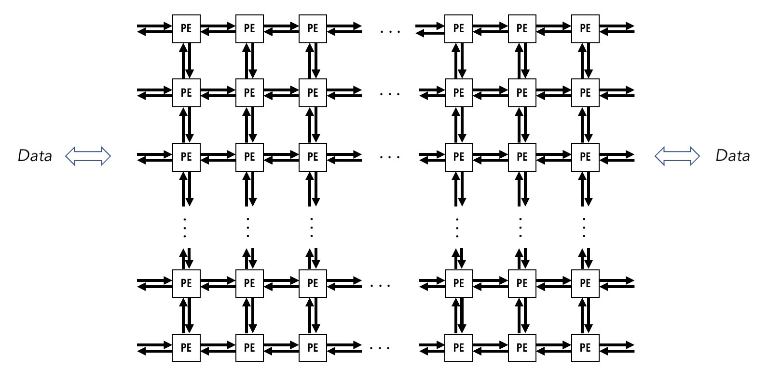
WSE conceptual high-level view
Very many individual Processing Elements (PEs)
These run independent of each other (e.g. their own program counter)
PEs are connected by 2D rectangular mesh across the chip
32-bit messages (called wavelets) can be communicated with neighbours in a single cycle
The 40GB of WSE memory is distributed amongst the PEs
Each PE has its own private chunk of memory

Slide 6
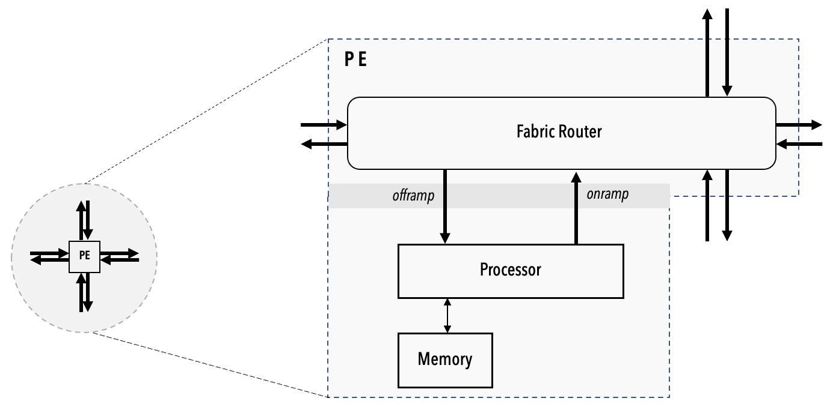
Within each Processing Element (PE)
We have the processor itself
Commonly referred to as the Compute Engine (CE)
Independent and private from any other
A router
Connected with bidirectional links to own CE and router of four neighbours
Link to own CE is called the RAMP and neighbours are referred to by north, south, east and west
This is the only way in which PEs can communicate
Local (private) memory
All data and code for the PE is stored in this memory
48KB per PE

Slide 7
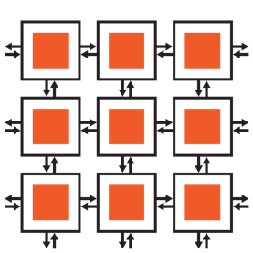
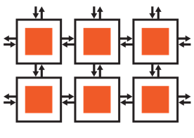
What is supported by the CE
…
16- and 32-bit native FP and integer data types are supported by the CE
Follows a dataflow execution model
Tasks are either triggered or activated
Independent programs specified for regions of PEs
Control flow is straightforward to reason about
Tasks are non-preemptive
Instruction to activate another task enable state-machine behavior
…
Data
…
Data
…
…
…
…
…
…
…
…
PE
Fabric router
Offramp
Onramp
Processor
Memory

Slide 8



From a programmer’s perspective
Host CPU(s): Python
Device: Cerebras Software Language (CSL)
Loads program onto simulator or CS-2 system
Streams in/out data from one or more workers
Reads/writes device memory
Target software simulator or CS-2
CSL programs run on groups of cores on the WSE, specified by programmer
Executes dataflow programs
Device Read/Write
Memory I/O + Data Streams

Slide 9
Programming the WSE
Cerebras Software Language (CSL) is used to actually program the device
As we will see, this provides both a series of abstractions for high level programming with the ability to get down into the low level details (builtins) if desired
CSL program consists of tasks and functions
Functions can be called by the host or another function on the device
Tasks are started by the hardware, run until completion, and then at that point the hardware chooses another task to run
Can only be activated, can not be called by other tasks or functions. Also don’t return a value
Each task has an associated ID that is used for tracking and management
var result: f32 = 0.0;
task main_task() void {
result = 5.0;
}

Slide 10
Communication between PEs
Remember, a wavelet is a 32-bit message communicated with a neighbour in a single cycle
Each physical channel has 24 virtual communication channels known as colors that can be used for passing wavelets
Each wavelet has associated with it a 5-bit identifier which defines which channel it is communicated on
Determines the wavelet’s routing through the fabric and its consumption
This is a bit like a tag in MPI point-to-point communications, and similarly many messages on one color does not block messages with a different color using the same physical link
Wavelets are consumed by tasks on a PE where a task is registered to execute when a wavelet arrives with a specific color

Slide 11
Three types of task
Data tasks
Which activate upon the arrival of a wavelet with a matching color, these are used to consume messages that are communicated between PEs
Wavelet Triggered Task (WTT)
Local tasks
Explicitly activated by other tasks or functions running on the PE
Control tasks
Like a data task (also wavelet triggered)
But not routable, useful for e.g. dynamically reconfiguring routes

Slide 12
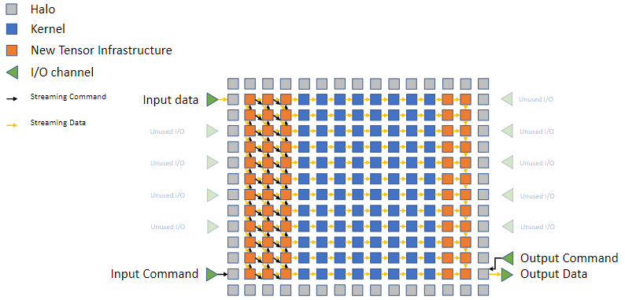
Host runtime
A host-side runtime known as SdkRuntime is provided
Memcpy library:
Transfer data on and off the WSE from host program, and launch device functions
The host and WSE network interfaces finally route the data into your kernel
(last step is implemented on the WSE itself to connect the I/O channel entry-points, which are in fixed locations at the edges of the WSE)
Uses additional PEs around the user kernel to route data
In addition to a halo around the kernel, the additional support PEs consume three columns on the West of the kernel and two columns on the East.

Slide 13
The CSL compiler
usage: cslc [-h] [-o OUTPUT_NAME] [--params PARAMS] [--colors COLORS] [--memcpy] [--channels CHANNELS]
[--import-path IMPORT_PATH] [--width-west-buf WIDTH_WEST_BUF] [--width-east-buf WIDTH_EAST_BUF] [--verbose]
csl_filename
Frontend for cslc-driver. Creates a directory and then calls cslc-driver which will write its output files to the created directory.
positional arguments:
csl_filename Input CSL file
optional arguments:
-h, --help Show this help message and exit
-o OUTPUT_NAME Output directory name (default: out)
--params PARAMS Comma-separated list of param-to-value mappings where a mapping is a `name:value` pair where name
is a string and value is an unsigned integer. The parameter list is passed on to cslc-driver as-is.
--colors COLORS Comma-separated list of color-to-value mappings where a mapping is a `color:value` pair where color
is a string and value is an unsigned integer. The parameter list is passed on to cslc-driver as-is.
--memcpy Add memcpy support to this program
--channels CHANNELS Number of memcpy I/O channels to use when memcpy support is compiled with this program.
--import-path IMPORT_PATH
Add the given directory to the list of directories searched for <...> paths in @import_module and
@set_tile_code statements.
--width-west-buf WIDTH_WEST_BUF
Width of west buffer (default is zero, i.e. no buffer to mitigate slow input)
--width-east-buf WIDTH_EAST_BUF
Width of east buffer (default is zero, i.e. no buffer to mitigate slow output)
--verbose Verbose output
Code is compiled using the cslc command
Generates .elf files which are the executable that will be loaded onto the CS-2
Will play with this in a few minutes

Slide 14
Use of the simulator
CS-2 machines are designed to be exclusive use
Routinely developing code directly on the CS-2 would be a big pain, due to contending with lots of other users at the same time!
Cerebras also provide a software simulator of the CS-2
Simulates execution of your program by running it on the CPU
This is highly accurate and should be used during development to test your code
But for performance measurements and production runs obviously we need the CS-2 itself
We will use the simulator quite heavily during this tutorial
But part of our hands-on exercises will be to run each of these on the CS-2 hardware itself once you have done the development

Slide 15

Clustering CS-2 machines
For ML applications, multiple CS-2 machines can be clustered into Wafer-Scale Cluster
This is not yet available for SDK applications

Slide 16
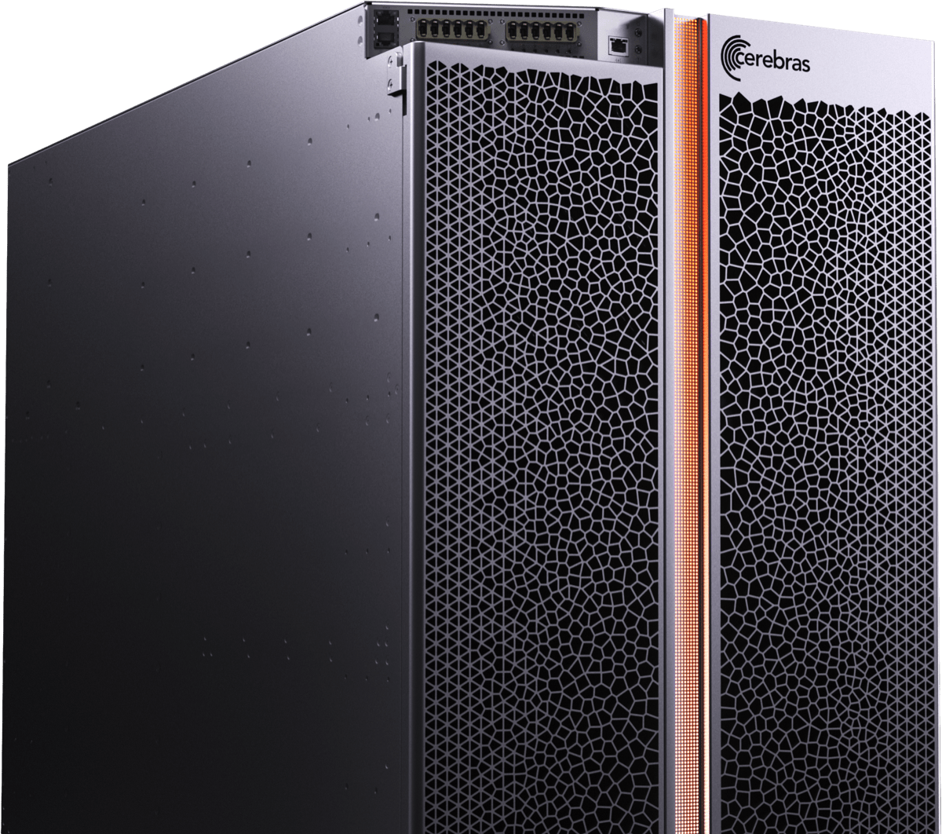
Conclusions
The CS-2 is a powerful architecture with significant raw compute and distributed memory
We have explored the general way in which the WSE is organised and the key concepts and terminology
Now we are going to move onto focussing on how to program the machine
You will see how these concepts are used practically in codes

